Slide 1

Modern Control Theory
Lecture No. 10
Conceptual Overview of Observer Design
Extending the Concept of Observer, towards Understanding of a Kalman Filter

Slide 2

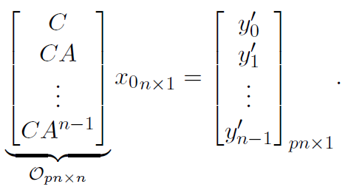


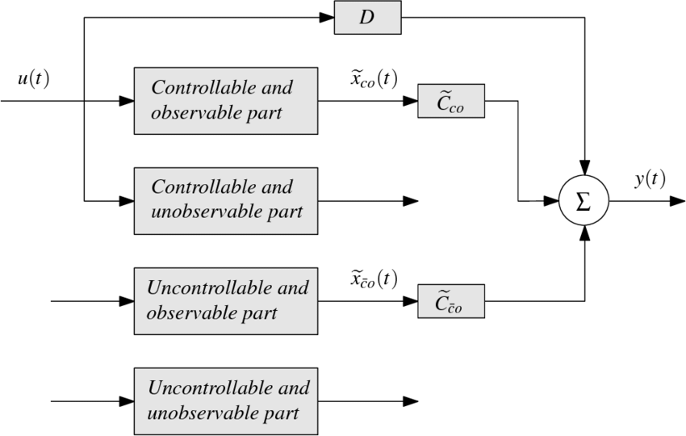

Controllability & Observability
Cols. of A --- Span the Complete Space of R
Matrix A has m l.i. Columns
All Rows of A are l.i. since No. of l.i Cols. = No. of l.i. Rows
Condn. on A to have at least one soln. for every vector b E R, is that A should be of full row rank

Slide 3
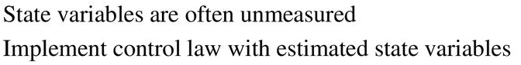
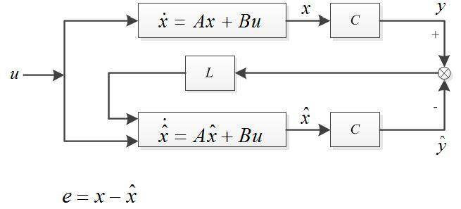
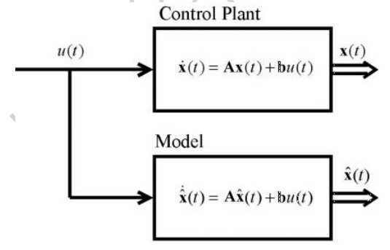
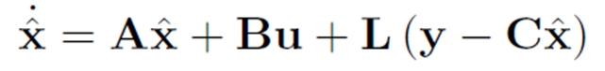
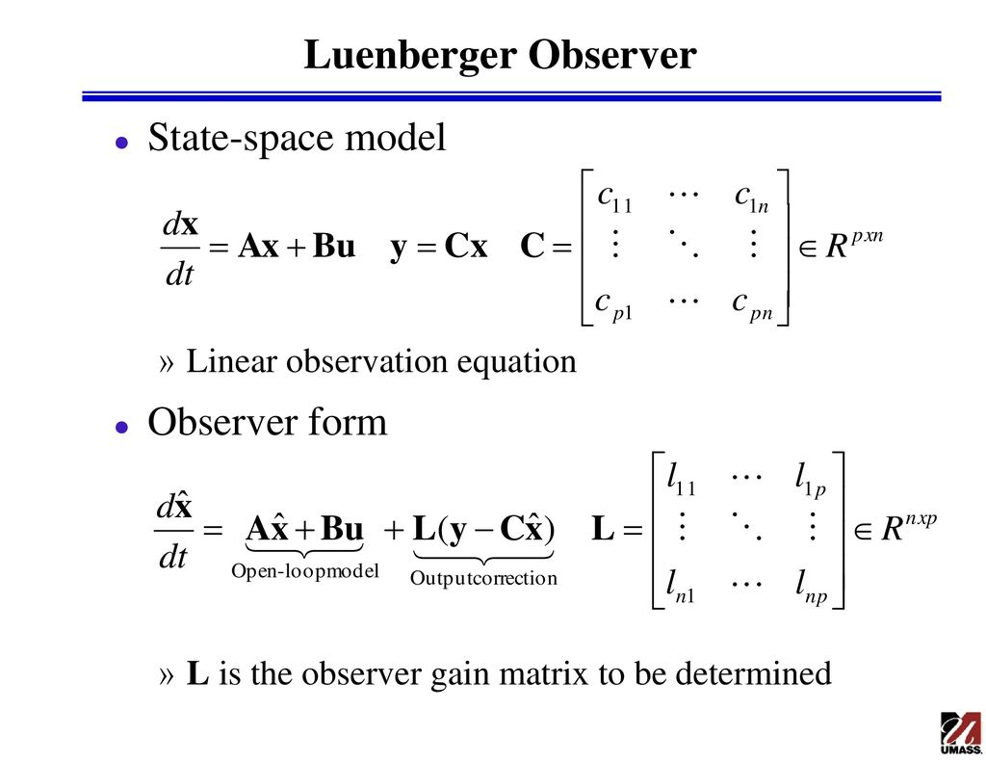
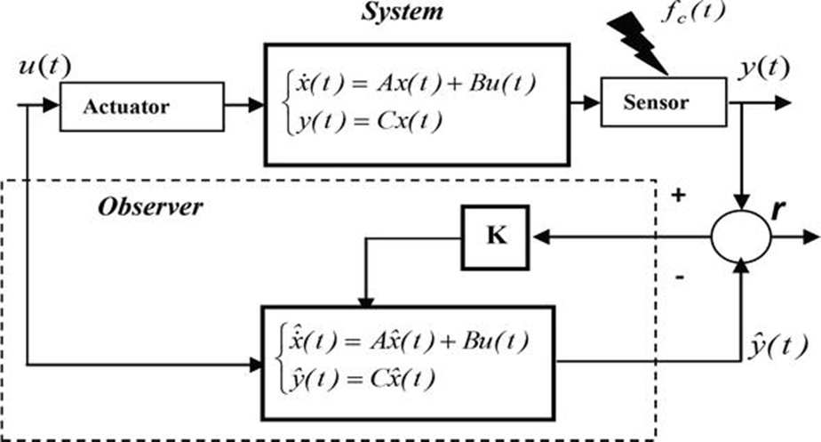
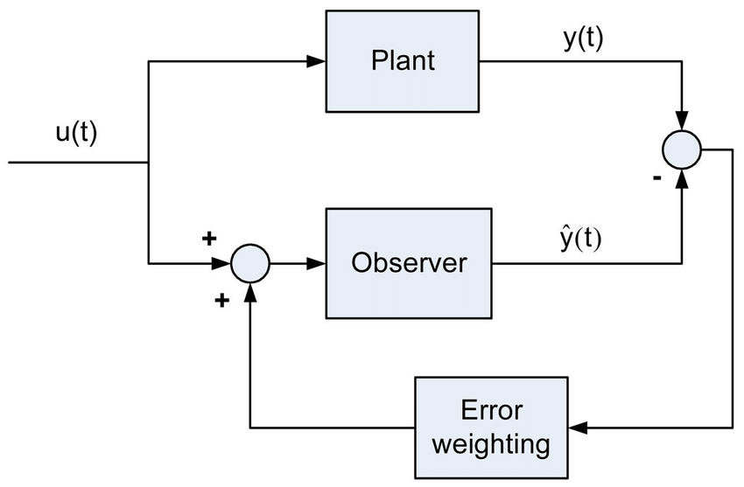
K
K

Slide 4
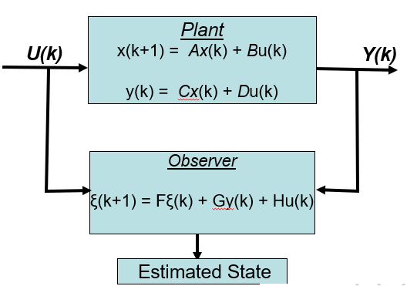
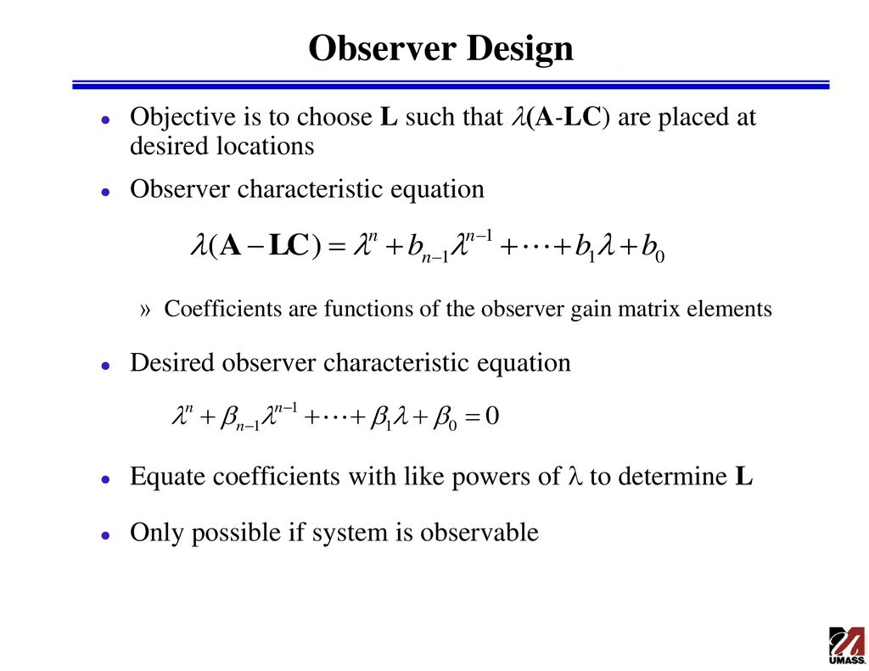


Conceptualizing a Full-Order Observer Design
Plant Characteristics Equation
Now Considering
Subtracting Observer Equation from State equation, the LHS is
Eigenvalues of F = A – GC should be placed by appropriate choice of G, such that (A, C) is Observable
A – GC = F & H = B - GD
We get
X(k + 1) --
e(k + 1 ) = (A – GC) e(k)

Slide 5
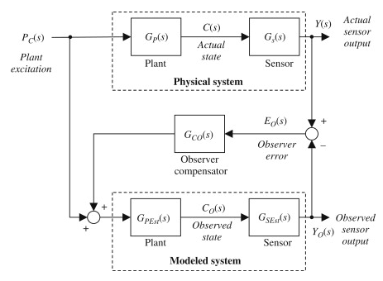
Visualizing the Observer from a Classical Control Viewpoint

Slide 6



Extending the Observer Concept to a Kalman Filter
Uncertainties in Process Models/State Equations
Uncertainties/Noise in Measurements

Slide 7
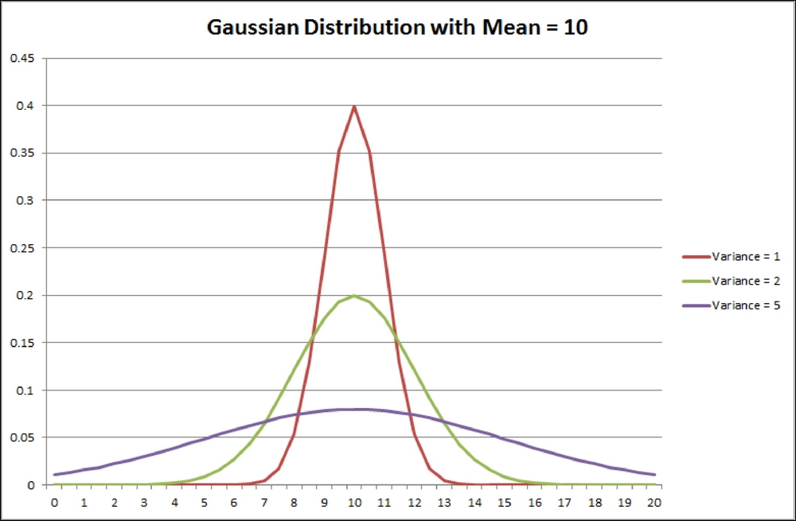

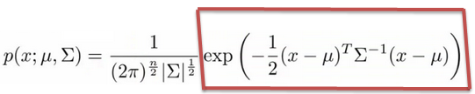
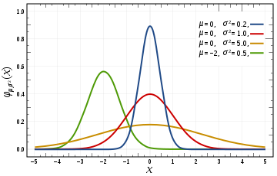
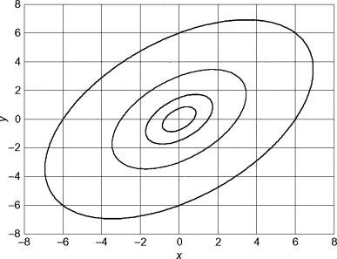
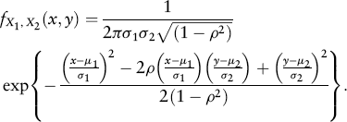
Gaussian Distribution

Slide 8
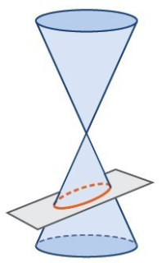
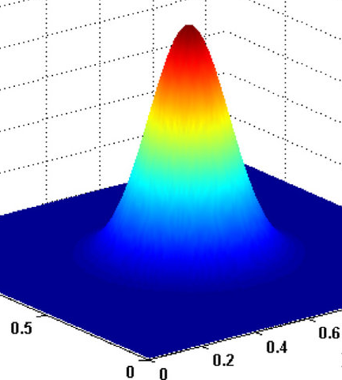
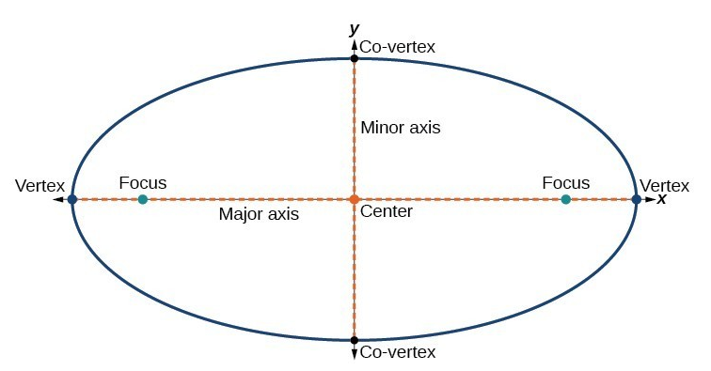
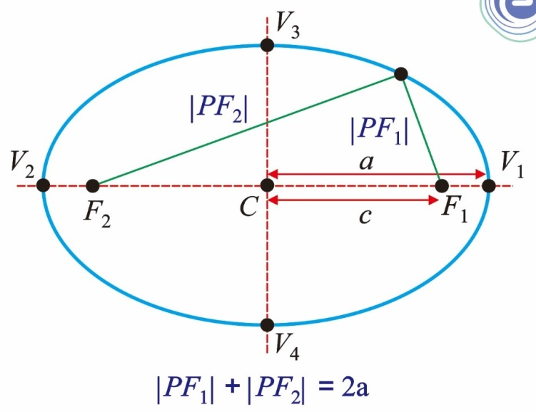
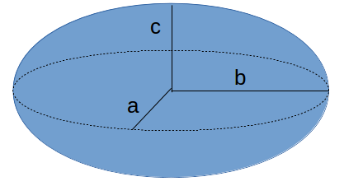
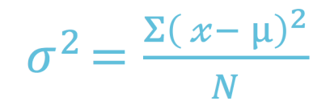
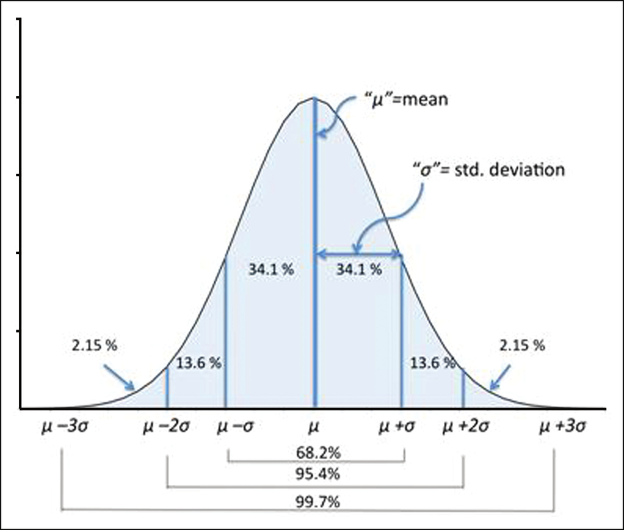
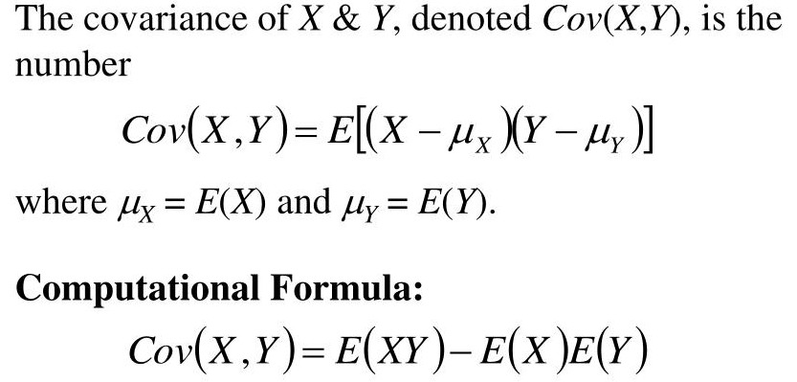
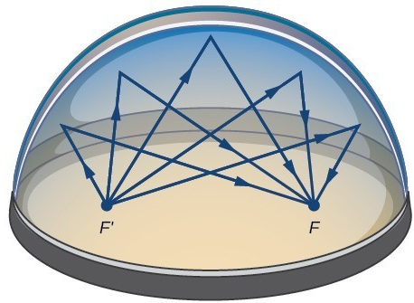



Ellipsoid as a Measure of Gaussian Uncertainty

Slide 9
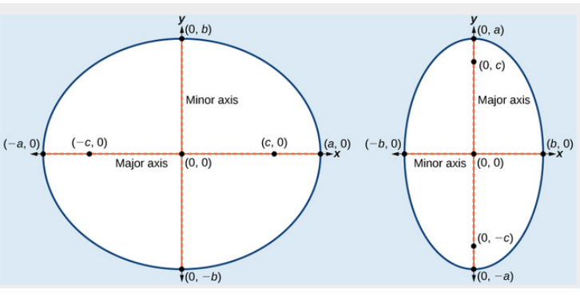
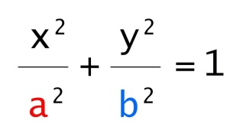
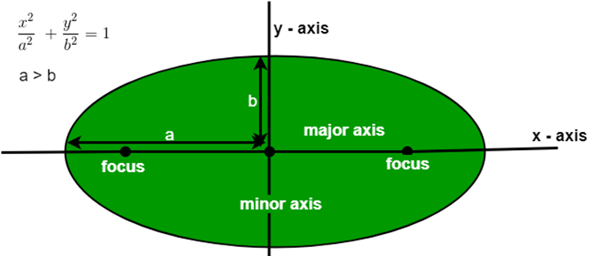
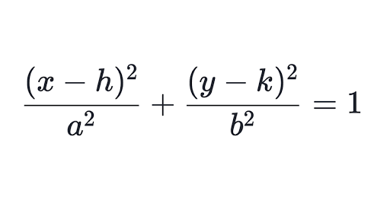
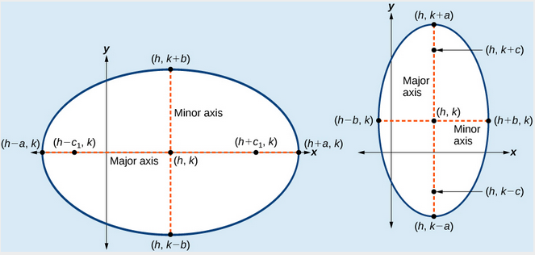
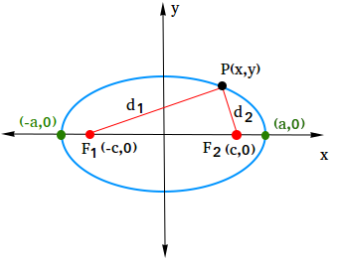
Further Insight of the Ellipse

